Slide 1

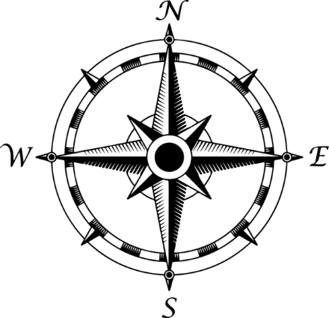
SciHive
SciHive Map
ONLINE

Slide 2
BeeBot

Slide 3
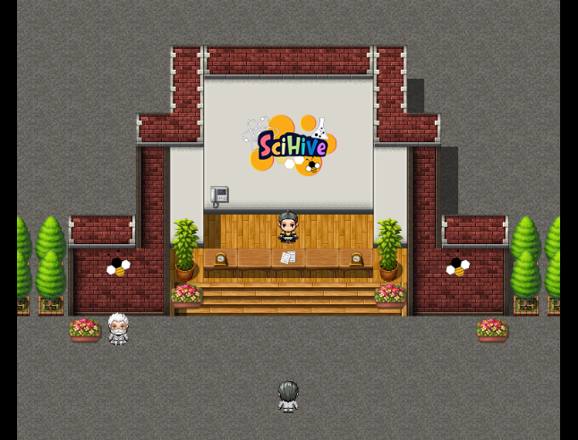

Slide 4


SciHive Office
Word Search
Columban College
Tower
Blocks
SciHive
ONLINE

